Slide 1
Chapter 8
Teamwork

Slide 2
Outline
How can information systems be used to support teams of workers?
How many different ways are there to communicate with team members? Which method is best for each type of message?
How can several people work on the same documents?
How does an organization remember past events?
Where can you find a system that provides these groupware capabilities?
What if you do not have a server and want to collaborate?
What could you accomplish if five people can work on the same screen at the same time?
How do you collaborate and share data if everyone uses different software?

Slide 3



Teamwork
 | 1 | 2 | 3 | 4 | 5 | 6
7 | 8 | 9 | 10 | 11 | 12 | 13
14 | 15 | 16 | 17 | 18 | 19 | 20
21 | 22 | 23 | 24 | 25 | 26 | 27
28 | 29 | 30 | 31
Alpha Project
Goals:
Problems:
Departments:
Dept | Costs | Labor
Mrkt | 445 | 87
Prod | 227 | 45
HRM | 554 | 32

Slide 4
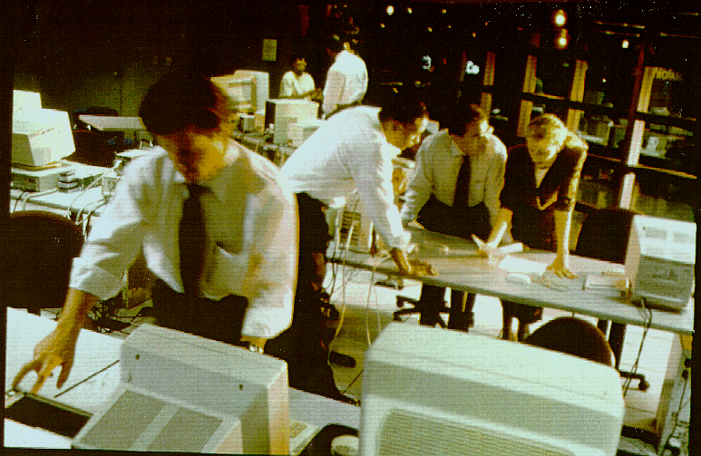
Workgroups
Computers are increasingly used to support teamwork and workgroups. Data, comments, and analysis are created and shared through networks of computers.

Slide 5



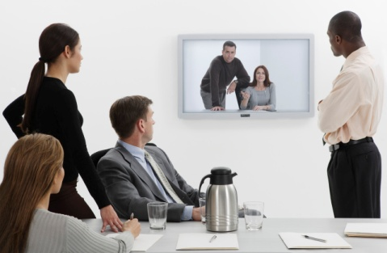
Communication Channels and Interruptions
Instant Message/Texting
E-Mail
Physical Visit
Phone Call
Which type of interruption is the least disruptive for you?
Need to finish your work.
Need to help the team.
Video conference

Slide 6



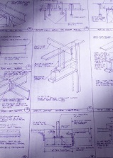


Problems with E-Mail as Groupware
Consulting HQ
California
Client HQ
New York
contract
changes
design
changes
Finance & Management Team
modified designs
changes
Singapore
Design Team
Design documents
Multiple copies
Different messages
Old versions
Which version is current?
Design Project

Slide 7


Web Sites and Blogs for Sharing
Web server
Web site
Blog
Author
One-way communication.
Easiest with one author.
Users search for data.
Coworkers

Slide 8

Scheduling: Shared Calendars
08:00 Meeting
08:30
09:00 Project A
09:30
10:00 Meeting?
10:30
11:00 Dentist
Calendar Server
(Microsoft Exchange)
08:00 Project B
08:30
09:00
09:30
10:00 Meeting?
10:30
11:00 Meeting
08:00 Project B
08:30
09:00 Project A
09:30
10:00 Meeting?
10:30
11:00 Project C

Slide 9



Online Conferences
Encoding Server
Conference Server
Internet
Microsoft Live Meeting, Cisco WebEx
Microsoft Communicator

Slide 10

Peer-to-Peer Complications: NAT
Company 1
Communication Server (fixed IP)
Company 2
NAT
NAT
Network Address Translation (NAT) prevents direct peer-to-peer connections.
A communication server with a fixed IP address serves as a bridge to allow users to connect to each other. Example: Microsoft Communicator.
Third-party companies like Skype, WebEx, and Microsoft run servers for a fee if your company lacks the expertise.

Slide 11

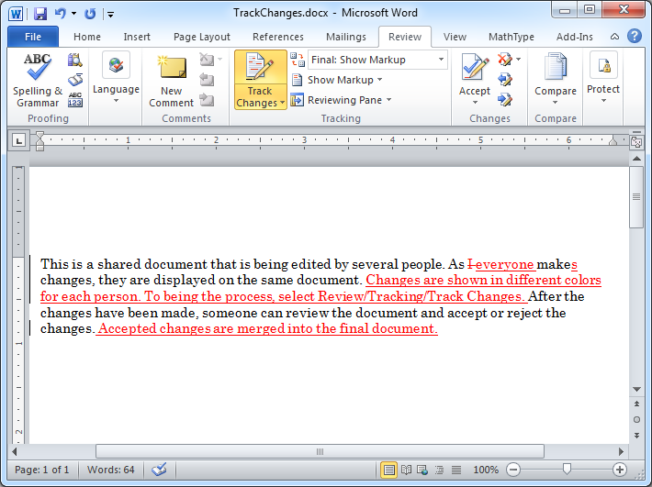

Collaboration Document

Slide 12
Version Control
Monday, initial version, Bob Jackson
Tuesday, new East forecast from marketing
Thursday, marketing implements a new forecasting formula
Monday, CEO throws out marketing formula, reverts to old and modifies West

Slide 13


Wikis and Web-based Applications
Web-based applications
Documents and Spreadsheets
In-house Wiki
(Job Descriptions)
Data and documents are shared on a Web server.

Slide 14
Information Rights Management
Document
Protected
Document
(Encrypted)
Decryption key
Workgroup server
User ID
authentication
Permission list
Information rights server
Document

Slide 15



Business Process Management: Workflow
Cost analysis
Management approval
3
Purchase
2
Multiple groups are involved in a major purchase. Costs and schedules are updated based on approvals. As events are completed other tasks are triggered automatically.
1
Manager review
Purchase Request

Slide 16

GDSS Room
Group decision support systems can be used to coordinate meetings, record notes, take votes, and encourage participation. As shown in this system by Ventana corporation, each participant enters data in a PC, with summary results displayed on the central screen.

Slide 17
GDSS
Group Decision Support Systems
Brainstorming
Shared access
Voting
Record of comments
Anonymity?
Drawbacks
Typing
Facilitator
Costs

Slide 18
Knowledge Management
Storing the organization’s documents is an important function.
SharePoint Portal also provides detailed indexes, cross-reference links, and searches.
You might still need additional software
You will likely need a company librarian to help organize the documents and provide better categorization and cross-references

Slide 19

Service Processes and Quality
Processes and workflow
Employee
Client
Steps:
Client Interview
Project definition
Data collection
Forecasts
Assessment Measures
Quality
Productivity
Process evaluation and continual improvement

Slide 20
SharePoint Overview
Communication
Contacts
E-mail
Chat
Discussion
Survey
Lists
Project management
Tasks
Schedule
Calendar
Collaboration
Libraries
Shared documents
Tracking changes
Version control
Wiki
Workflow
Routing
Alerts
Programmable

Slide 21
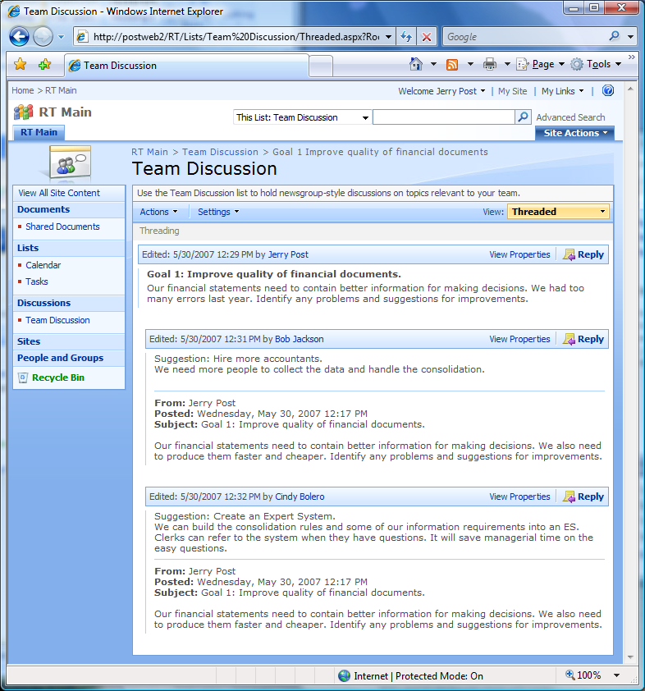
SharePoint: Discussion

Slide 22
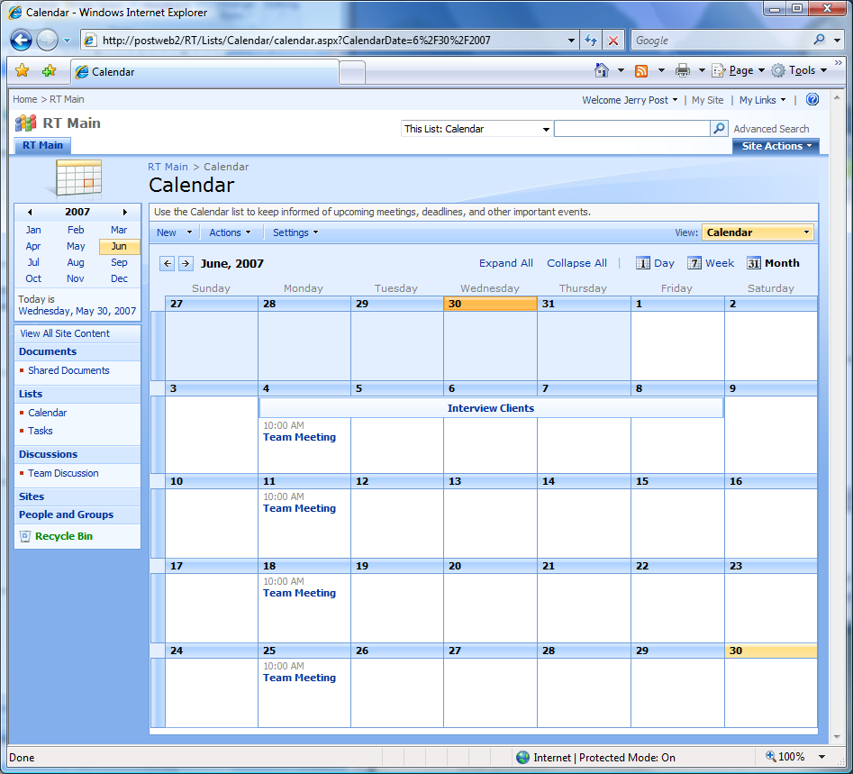
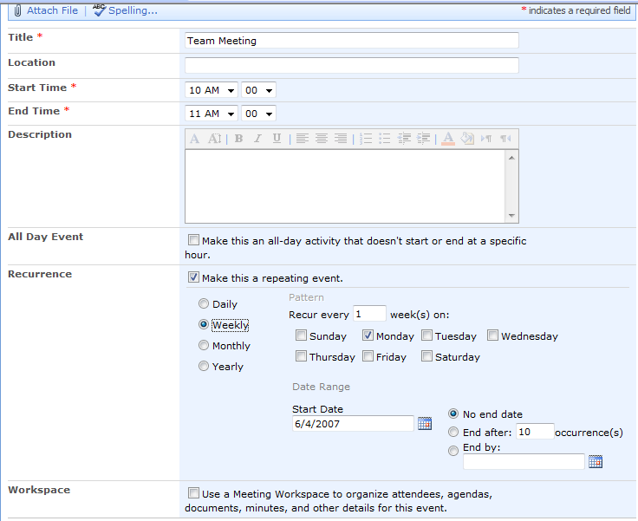
SharePoint: Project Events
Event Calendar
Recurring Event

Slide 23
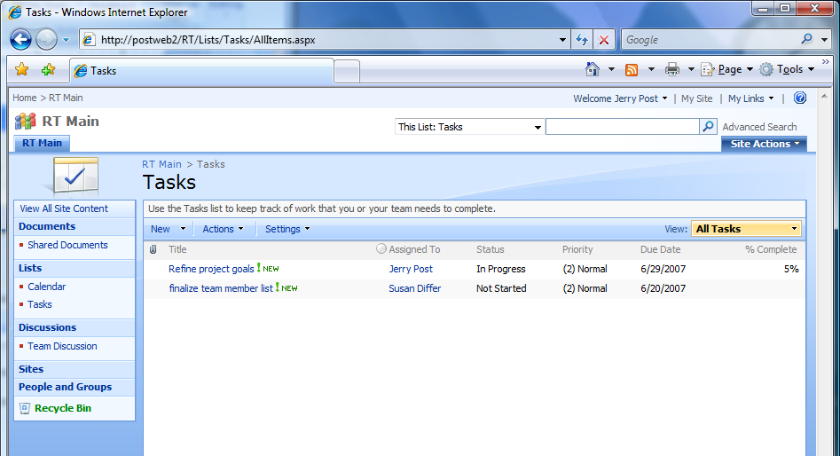
SharePoint: Project Tasks

Slide 24
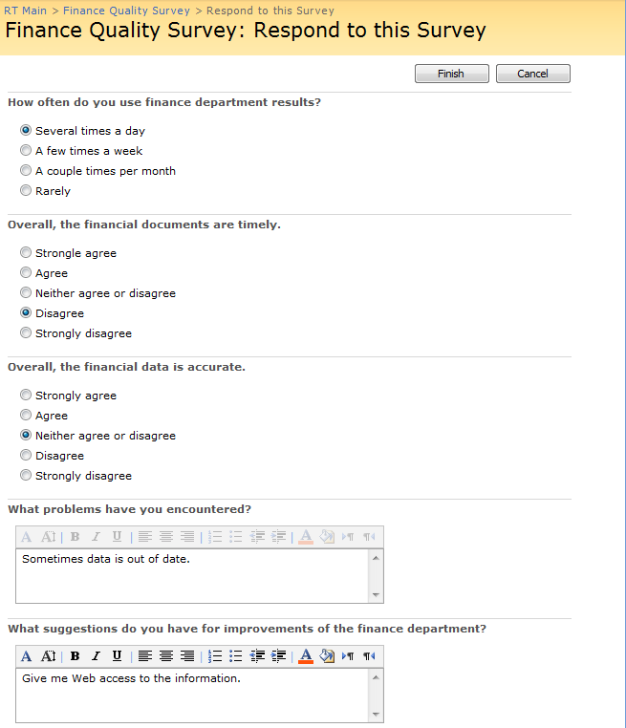
SharePoint: Survey

Slide 25
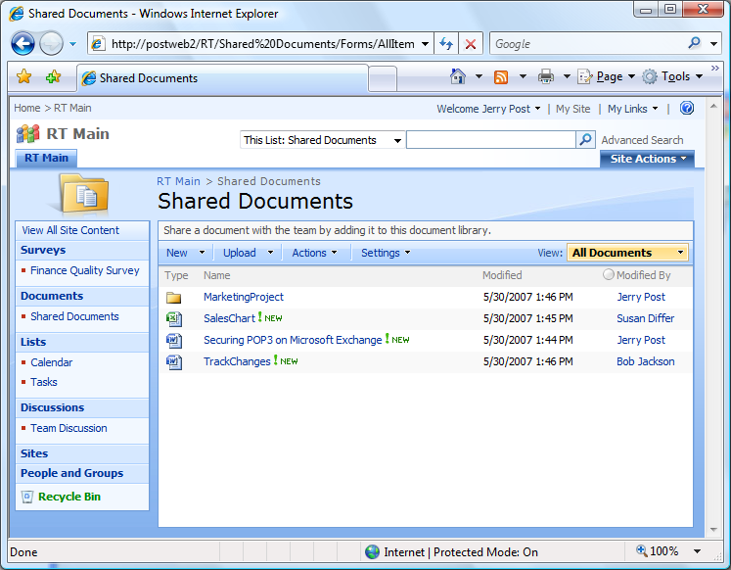
SharePoint: Shared Documents

Slide 26
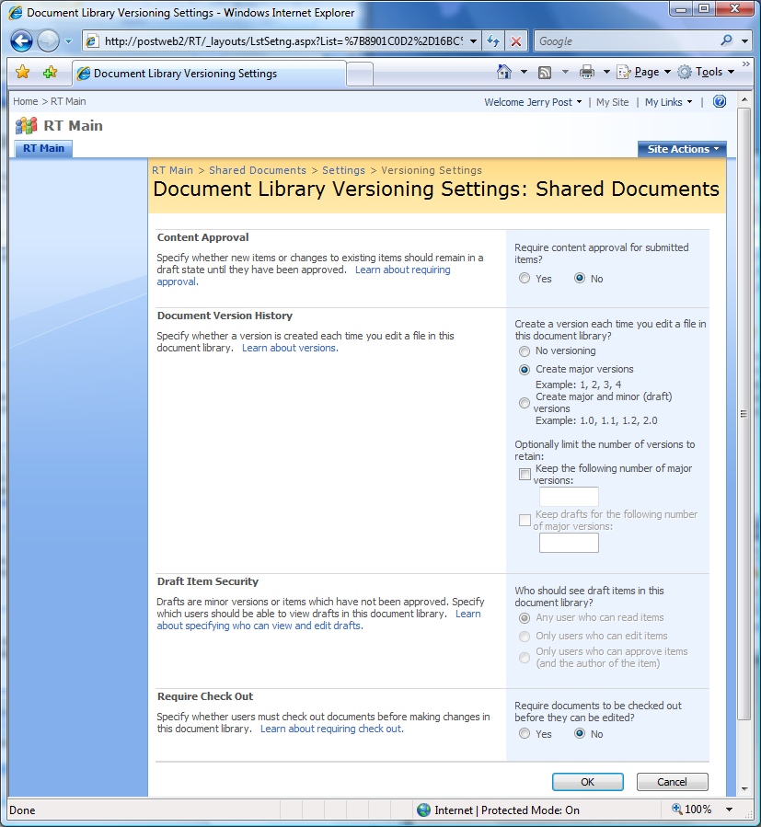
SharePoint: Configure Version Control
From document library
Settings/
Document Library Settings/ General Settings/
Versioning Settings

Slide 27
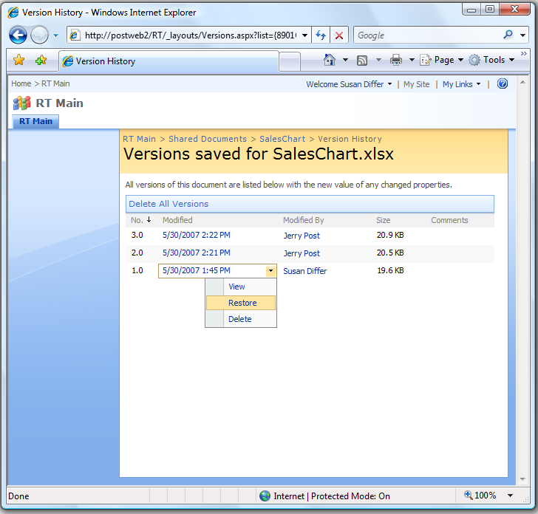
SharePoint: Version Control

Slide 28
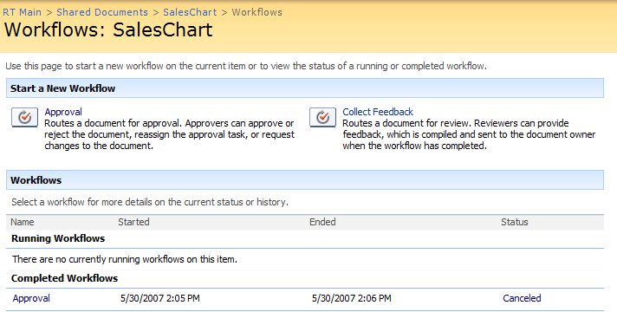
SharePoint: Workflow
A workflow schedule sequentially e-mails the document to selected users.
Workflow types:
Approval – approve, reject, forward to someone else, request changes
Collect Feedback – sent to originator when process is completed
Collect Signature (digital)
Disposition Approval – agree to remove expired data

Slide 29
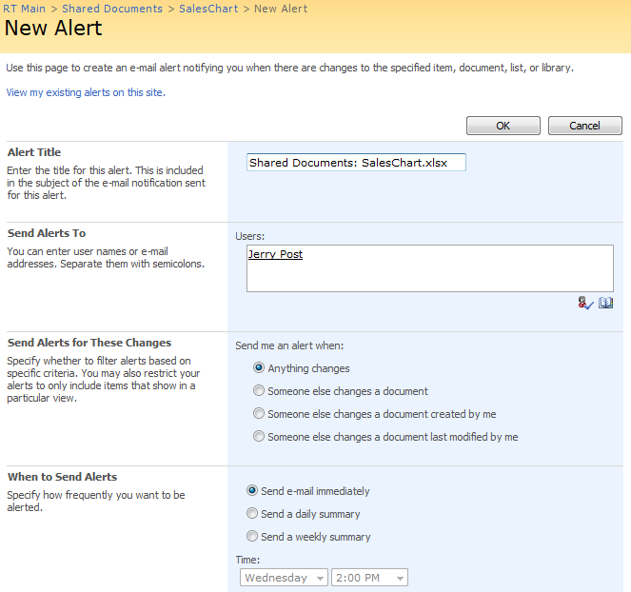
SharePoint: Alerts

Slide 30
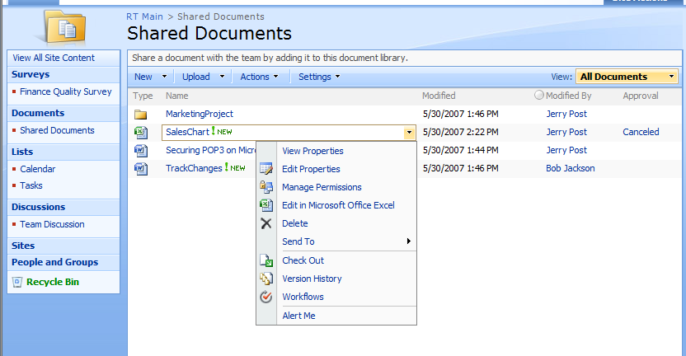
SharePoint: Document Actions

Slide 31
SharePoint: Configuration
Templates are used to quickly define standard types of sites.
Color schemes are easy to change and add.
SharePoint Designer adds flexibility to create new templates and integrate with other software.
SharePoint is built on top of Microsoft ASP .NET 2.0, which is a comprehensive Web server programming language. Programmers can develop and integrate complex tools into SharePoint.
Web Parts are pre-built modules to handle specific complex tasks. For example, the Excel Web Part enables you to generate new worksheets from code.

Slide 32
Peer-to-Peer Interaction
Communication: Voice, Video, Chat/IM
Microsoft Communicator
Third-party servers (Skype, WebEx, LiveMeeting)
Shared Applications
Meeting Space (old: NetMeeting)
Third-party servers (WebEx, LiveMeeting)
One Note/Live Sharing
Google applications
Replication and Synchronization
Groove
One Note/Shared Folders
Network Address Translation is a big problem
Need a server (internal or third-party) with fixed IP address.
Possible resolution with IPv6, but will take time (years).

Slide 33

Groove (SharePoint Workspace)
New Workspace
Files
Discussion
Calendar
Workspace
Replica
Synchronized
when connected
Workspace
Replica

Slide 34
Interaction: Meeting Space
Shared Document
Each person sees the same document or application. Even if they do not have the software installed on their machines. Any person can be given control to type text or control the application.
Discontinued Microsoft Product

Slide 35
Microsoft SharedView
Download from Microsoft
Join Microsoft Live.
Share screen, keyboard, and mouse. One person has control at a time.
Microsoft embeds advertising into Live Messenger and SharedView.
Discontinued Microsoft Product
Died after Windows 7 + IE 9

Slide 36
Online Tools (Sample List)
Tool | Site
Brainstorming/Associations
Mind Maps | www.mindmapping.com
Bubbl | www.bubbl.us
Mind Meister | www.mindmeister.com
Spinscape | www.spinscape
Documents and Drawing
Show Document | www.showdocument.com
Twiddla | www.twiddla.com
Writeboard | www.writeboard.com
Google Docs | docs.google.com
Zoho | www.zoho.com
Microsoft Live or 365 | www.microsoft.com/live
Wikidot | www.wikidot.com
Wikispaces | www.wikispaces.com

Slide 37
Online Sharing (Projects and Meetings)
Tool | Site
Project Planning
Wrike | www.wrike.com
WizeHive | www.wizehive.com
Basecamp | www.basecamp.com
Meetings and Sharing
Adobe | https://acrobat.com/welcome.html
Microsoft Live Meeting | www.livemeetingplace.com
Cisco Webex | www.webex.com
Go to Meeting | www.gotomeeeting.com
Log Me In | www.logmein.com
Mikogo | www.mikogo.com

Slide 38
Collaboration Tool Summary
Tool | Notes
SharePoint (Microsoft) | Server-based, central, many users, configurable, version control, workflow
Groove (Microsoft) | Peer-to-peer, File sharing, limited number of users, easy to set up
Online | Many, including LogmeIn.com
Live Messenger (Microsoft) Skype/AIM/Yahoo/more | Communication, chat, voice, video
Google Docs Microsoft Live | Server-based, external, simple documents
Exchange (Microsoft) Notes (Lotus/IBM) | E-mail system, store documents and history, shared calendars, workflow
WebEx (Cisco) Live Meeting (Microsoft) GoToMeeting | Web meeting to share slides and broadcast, typically requires telephone audio

Slide 39
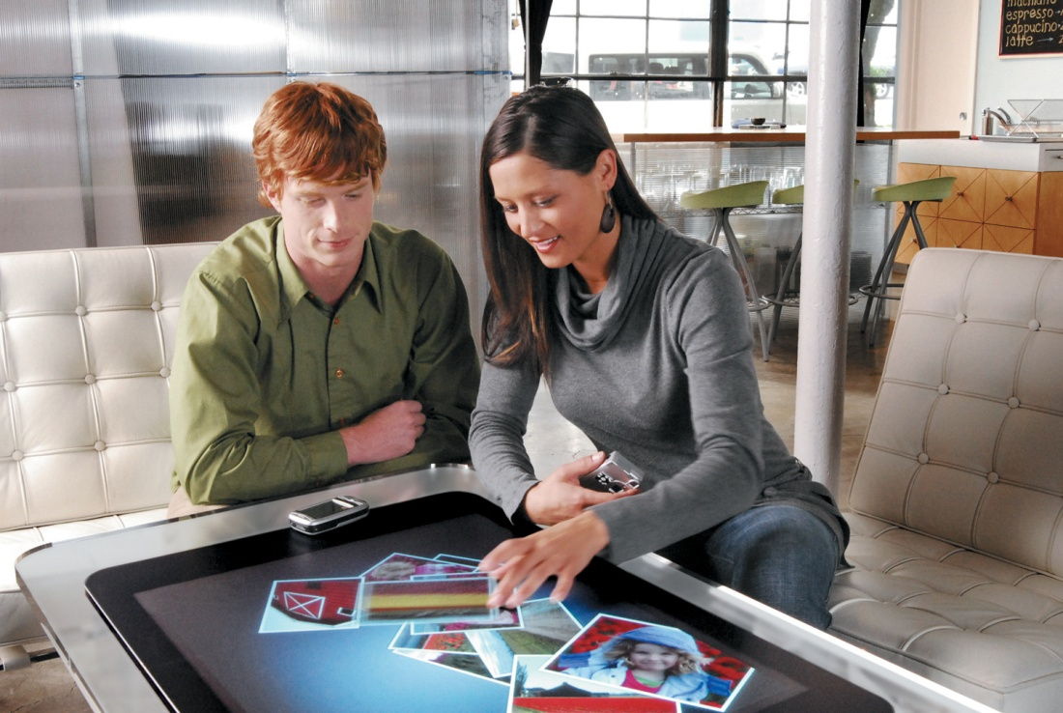
Multi-Touch, Multi-User
http://www.microsoft.com/surface/ Microsoft
http://multi-touch-screen.com/ PQ Labs

Slide 40
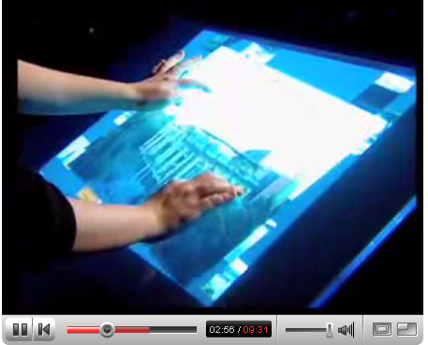
Multi-Touch: Jeff Han
Jeff Han Presentation February 2006 time: 9:31
http://www.youtube.com/watch?v=QKh1Rv0PlOQ

Slide 41
Problems with Sharing
Same software
Data conversion tools weak.
Exact layouts require same versions.
Open Document Format (ODF)
Download Office converter from www.sourceforge.net
Might someday make it easier for competitors to interoperate
Same environment, fonts, devices, drivers
Hardware conversions not exact.
Missing devices might cause crashes.
Need access and network paths.
Transmission time.
Concurrency
Tracking.
Locking.
Replication.

Slide 42
Cloud-Based Collaboration
Google Docs—can buy business account.
Office Live—integrates better with PC.
Both have similar features and limitations.
Store documents on server.
Provide backups.
Edit within browser—useful for tablets.
Hard to copy-and-paste among tools.
Both allow sharing
Control who sees and edits files.
Simultaneous changes pushed to multiple people.

Slide 43
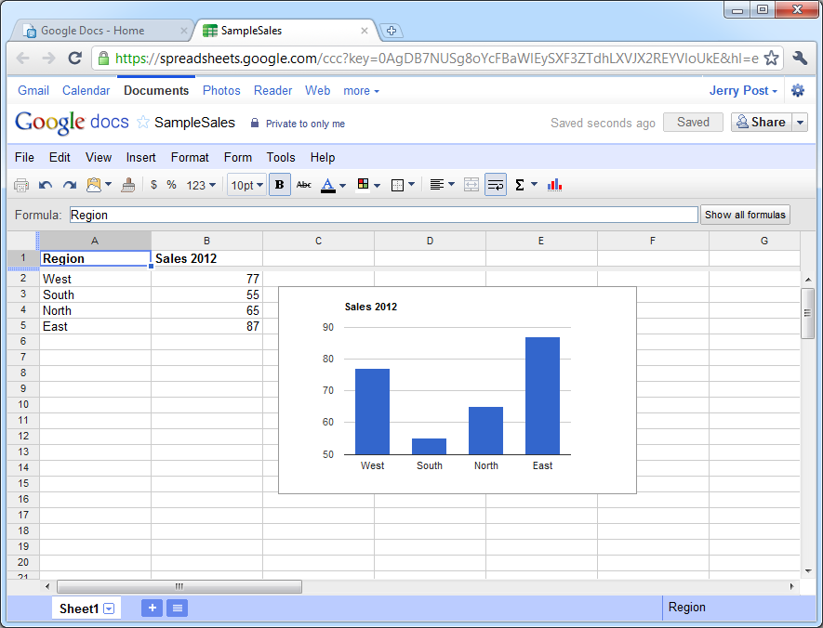
Google Docs
http://www.google.com/docs

Slide 44
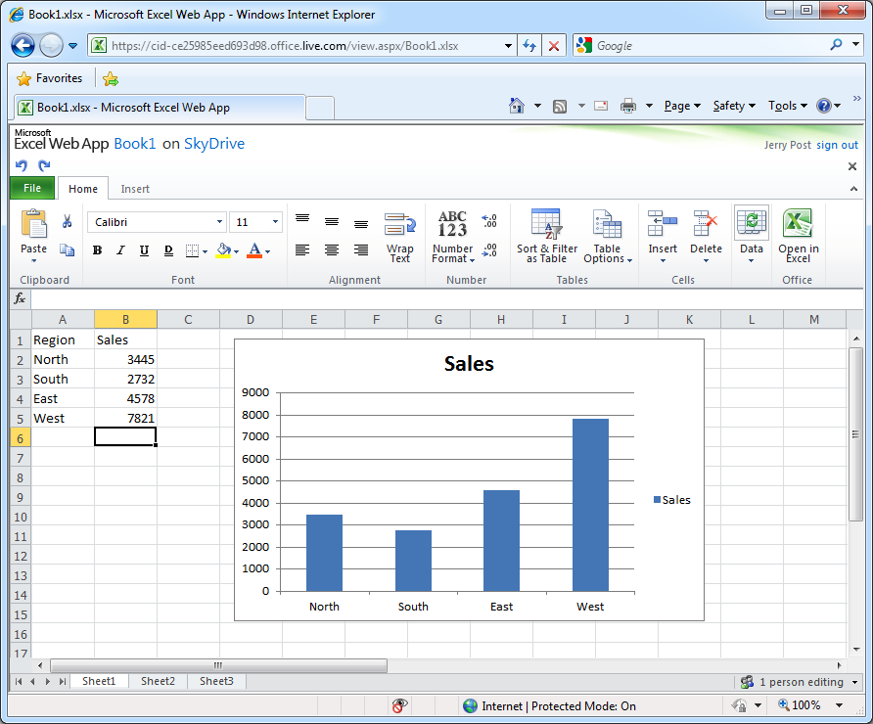
Microsoft Live
http://office.live.com

Slide 45
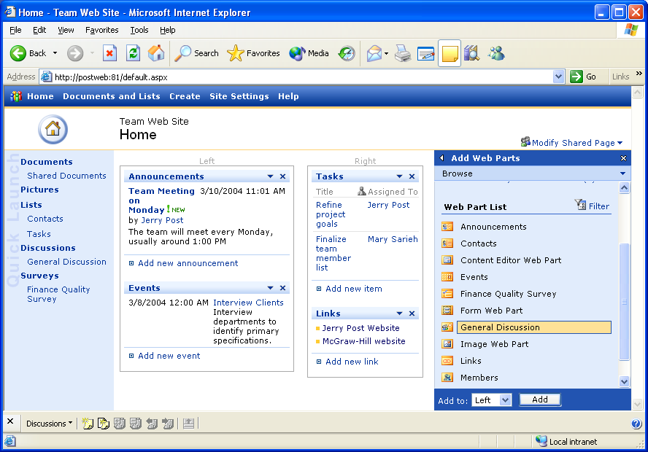
Technology Toolbox: SharePoint
Need a Windows 2008 Server
Follow configuration instructions
Create subfolders and assign members and permissions

Slide 46
Quick Quiz: SharePoint
1. Why would you want to configure the home page differently for different projects?
2. Is there a limit to the number of people you would want to place on a SharePoint team?
3. Research the two products and list the additional features provided by SharePoint Portal.

Slide 47
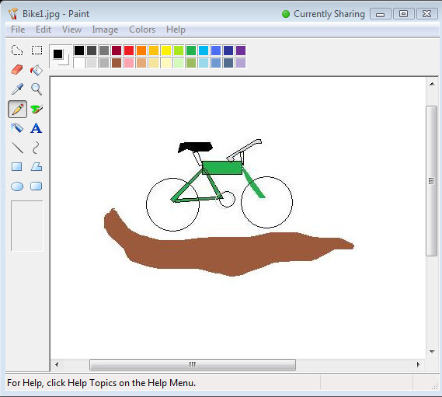
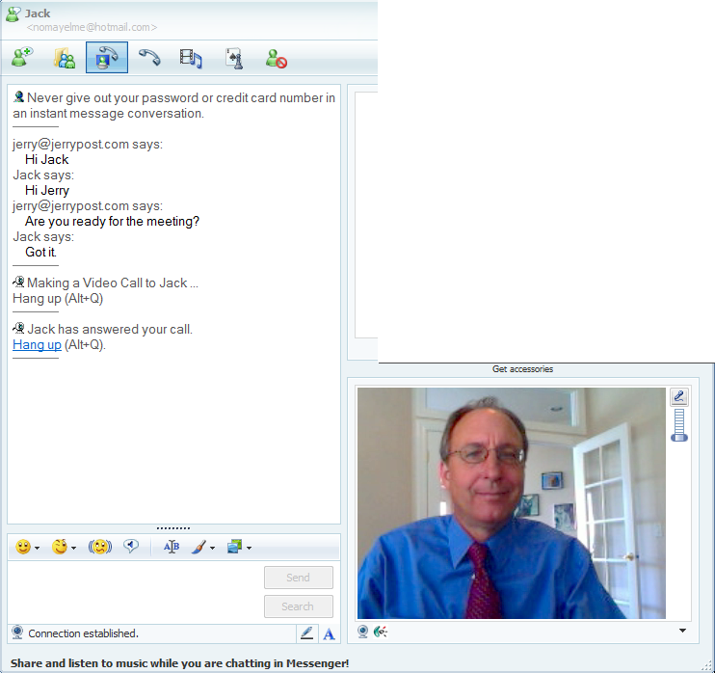
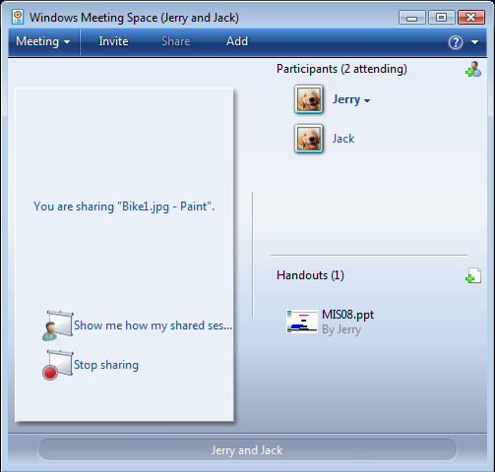
Technology Toolbox: SharedView+ IM
Share program (Paint) or Desktop
SharedView
Handouts
Share program
Instant Messenger: Chat + Video
Send Invitation

Slide 48
Quick Quiz: Shared View
What problems are you likely to encounter if more than four or five participants try to use online meeting software?
Why is voice communication important in an online meeting?
3. Is a video connection critical to online meetings?

Slide 49
Cases: Package Delivery
The Deutsche Post revenue is affected by exchange rates

